Slide 1
Managing the Essential Technologies and Operations
An IT architecture is a blueprint.
A blueprint shows how a system, house, vehicle, or product will look and how the parts interrelate.
An IT infrastructure is the implementation of an architecture.
The IT infrastructure includes the processors, software, databases, electronic links, and data centers as well as the standards that ensure the components work together, the skills for managing the operation etc.

Slide 2
Distributed systems: overall architecture
A collection of independent computers that appears to its users as a single coherent system.
Features:
No shared memory – message-based communication
Each runs its own local OS
Heterogeneity
Ideal: to present a single-system image:
The distributed system “looks like” a single computer rather than a collection of separate computers.

Slide 3
Distributed System Characteristics
To present a single-system image:
Hide internal organization, communication details
Provide uniform interface
Easily expandable
Adding new computers is hidden from users
Continuous availability
Failures in one component can be covered by other components
Supported by middleware

Slide 4
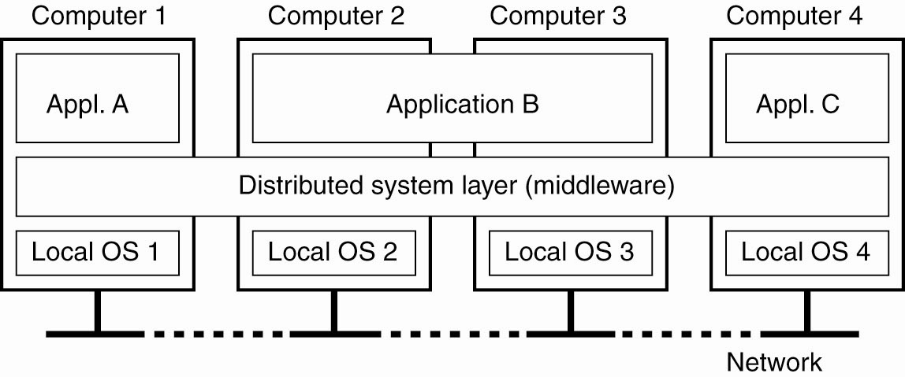
Definition of a Distributed System
Figure 3-1. A distributed system organized as middleware. The middleware layer runs on all machines, and offers a uniform interface to the system

Slide 5
Role of Middleware (MW)
In some early research systems: MW tried to provide the illusion that a collection of separate machines as a single computer.
Today:
clustering software allows independent computers to work together closely
MW also supports seamless access to remote services, doesn’t try to look like a general-purpose OS

Slide 6
Middleware Examples
CORBA (Common Object Request Broker Architecture)
DCOM (Distributed Component Object Management) – being replaced by .net
Sun’s ONC RPC (Remote Procedure Call)
RMI (Remote Method Invocation)
SOAP (Simple Object Access Protocol)

Slide 7
Middleware Examples
All of the previous examples support communication across a network:
They provide protocols that allow a program running on one kind of computer, using one kind of operating system, to call a program running on another computer with a different operating system
The communicating programs must be running the same middleware.

Slide 8
Distributed System Goals
Resource Accessibility
Distribution Transparency
Openness
Scalability

Slide 9
Resource Availability
Support user access to remote resources (printers, data files, web pages, CPU cycles) and the fair sharing of the resources
Economics of sharing expensive resources
Performance enhancement – due to multiple processors; also due to ease of collaboration and info exchange – access to remote services
Groupware: tools to support collaboration
Resource sharing introduces security problems.

Slide 10
Distribution Transparency
Software hides some of the details of the distribution of system resources.
Makes the system more user friendly.
A distributed system that appears to its users & applications to be a single computer system is said to be transparent.
Users & apps should be able to access remote resources in the same way they access local resources.
Transparency has several dimensions.

Slide 11
Types of Transparency
Transparency | Description
Access | Hide differences in data representation & resource access (enables interoperability)
Location | Hide location of resource (can use resource without knowing its location)
Migration | Hide possibility that a system may change location of resource (no effect on access)
Replication | Hide the possibility that multiple copies of the resource exist (for reliability and/or availability)
Concurrency | Hide the possibility that the resource may be shared concurrently
Failure | Hide failure and recovery of the resource. How does one differentiate betw. slow and failed?
Relocation | Hide that resource may be moved during use
Figure 3-2. Different forms of transparency in a distributed system

Slide 12
Degrees of Transparency
Trade-off: transparency versus other factors
Reduced performance: multiple attempts to contact a remote server can slow down the system – should you report failure and let user cancel request?
Too much emphasis on transparency may prevent the user from understanding system behavior.
Notes:
Relate to extensible OS arguments.

Slide 13
Openness
An open distributed system “…offers services according to standard rules that describe the syntax and semantics of those services.” In other words, the interfaces to the system are clearly specified and freely available.
Compare to network protocols
Interface Definition/Description Languages (IDL): used to describe the interfaces between software components, usually in a distributed system
Definitions are language & machine independent
Support communication between systems using different OS/programming languages; e.g. a C++ program running on Windows communicates with a Java program running on UNIX
Communication is usually RPC-based.

Slide 14
Examples of IDLs Goal 3-Openness
IDL: Interface Description Language
WSDL: Web Services Description Language
Provides machine-readable descriptions of the services
OMG IDL: used for RPC in CORBA
OMG – Object Management Group

Slide 15
Open Systems Support …
Interoperability: the ability of two different systems or applications to work together
A process that needs a service should be able to talk to any process that provides the service.
Multiple implementations of the same service may be provided, as long as the interface is maintained
Portability: an application designed to run on one distributed system can run on another system which implements the same interface.
Extensibility: Easy to add new components, features

Slide 16
Scalability
Dimensions that may scale:
With respect to size
With respect to geographical distribution
With respect to the number of administrative organizations spanned
A scalable system still performs well as it scales up along any of the three dimensions.

Slide 17
Size Scalability
Scalability is negatively affected when the system is based on
Centralized server: one for all users
Centralized data: a single data base for all users
Centralized algorithms: one site collects all information, processes it, distributes the results to all sites.
Complete knowledge: good
Time and network traffic: bad

Slide 18
Scalability - Administrative
Different domains may have different policies about resource usage, management, security, etc.
Trust often stops at administrative boundaries
Requires protection from malicious attacks

Slide 19
Scaling Techniques
Scalability affects performance more than anything else.
Three techniques to improve scalability:
Hiding communication latencies
Distribution
Replication

Slide 20
Hiding Communication Delays
Structure applications to use asynchronous communication (no blocking for replies)
While waiting for one answer, do something else; e.g., create one thread to wait for the reply and let other threads continue to process or schedule another task
Download part of the computation to the requesting platform to speed up processing
Filling in forms to access a DB: send a separate message for each field, or download form/code and submit finished version.
i.e., shorten the wait times

Slide 21
Distribution
Instead of one centralized service, divide into parts and distribute geographically
Each part handles one aspect of the job
Example: DNS namespace is organized as a tree of domains; each domain is divided into zones; names in each zone are handled by a different name server.

Slide 22
Types of Distributed Systems
Distributed Computing Systems
Clusters
Grids
Clouds
Distributed Information Systems
Transaction Processing Systems
Enterprise Application Integration
Distributed Embedded Systems
Home systems
Health care systems
Sensor networks

Slide 23
Cluster Computing
A collection of similar processors (PCs, workstations) running the same operating system, connected by a high-speed LAN.
Parallel computing capabilities using inexpensive PC hardware
Replace big parallel computers (MPPs)

Slide 24
Cluster Types & Uses
High Performance Clusters (HPC)
run large parallel programs
Scientific, military, engineering apps; e.g., weather modeling
Load Balancing Clusters
Front end processor distributes incoming requests
server farms (e.g., at banks or popular web site)
High Availability Clusters (HA)
Provide redundancy(Repetition of messages to reduce the probability of errors in transmission) – back up systems
May be more fault tolerant than large mainframes

Slide 25
Clusters – Beowulf model
Linux-based
Master-slave paradigm
One processor is the master; allocates tasks to other processors, maintains batch queue of submitted jobs, handles interface to users
Master has libraries to handle message-based communication or other features (the middleware).

Slide 26
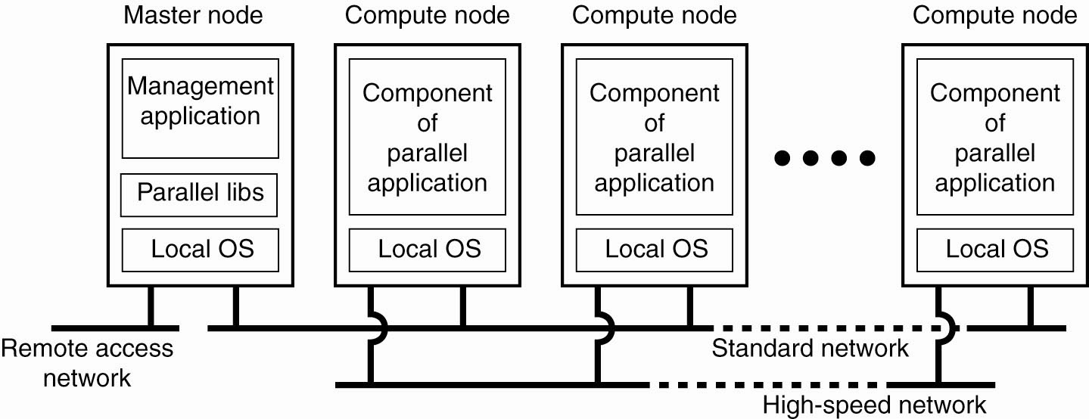
Cluster Computing Systems
Figure 1-6. An example of a cluster computing system.
Figure 3-6. An example of a (Beowolf) cluster computing system

Slide 27
Grid Computing Systems
Modeled loosely on the electrical grid.
Highly heterogeneous with respect to hardware, software, networks, security policies, etc.
Grids support virtual organizations: a collaboration of users who pool resources (servers, storage, databases) and share them
Grid software is concerned with managing sharing across administrative domains.

Slide 28
Grids
Similar to clusters but processors are more loosely coupled, tend to be heterogeneous, and are not all in a central location.
Can handle workloads similar to those on supercomputers, but grid computers connect over a network (Internet?) and supercomputers’ CPUs connect to a high-speed internal bus/network
Problems are broken up into parts and distributed across multiple computers in the grid – less communication between parts than in clusters.

Slide 29
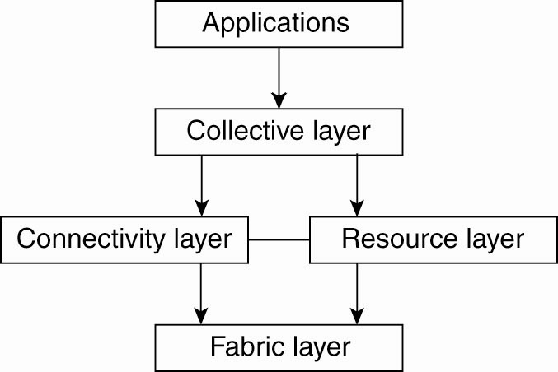
A Proposed Architecture for Grid Systems*
Fabric layer: interfaces to local resources at a specific site
Connectivity layer: protocols to support usage of multiple resources for a single application; e.g., access a remote resource or transfer data between resources; and protocols to provide security
Resource layer manages a single resource, using functions supplied by the connectivity layer
Collective layer: resource discovery, allocation, scheduling, etc.
Applications: use the grid resources
The collective, connectivity and resource layers together form the middleware layer for a grid
Figure 3-7. A layered architecture for grid computing systems

Slide 30
Cloud Computing
Provides scalable services as a utility over the Internet.
Often built on a computer grid
Users buy services from the cloud
Grid users may develop and run their own software
Cluster/grid/cloud distinctions blur at the edges!

Slide 31
Systems responsibilities can be distributed unless the following are true:
1. Are the operations interdependent?
When it is important that one operation knows what other is doing; their planning, development, resources, and operations must be centralized.
2. Are the businesses really homogenous?
3. Does the corporate culture support decentralization?

Slide 32
Managing Information
Once enterprises get their data into shape, that data can more easily be turned into information.
“Information is power.” “We are in the Information Age.”
These and similar statements would lead you to believe that managing information is a key corporate activity. Technology = infrastructure; asset = information that runs on that infrastructure.
Four Types of Information
Internal record-based information, such as those found in databases
Internal document-based information, such as reports, opinions, e-mails and proposals. Pertains to concepts: ideas, thoughts, etc.
External/record-based information, such as acquisition from external databases.
External/document-based: WWW

Slide 33
Cont..
Managing Information: Data Warehouses
Data warehouse: Houses data used to make decisions. This data is obtained periodically from transaction databases. Data warehouses differ from operational databases in that they do not house data used to process daily transactions.
Key Concepts of Data Warehouse
Metadata: is the part of the warehouse that defines the data. Metadata means “data about data.” it explains the meaning of each data element, how each element relates to each other, etc.
Quality data: is the cleaning process to adhere to metadata standards.
Data marts: is a subset of data pulled off the warehouse for a specific group of users.

Slide 34
Cont..
Five Steps in a Data Warehousing Project:
1. Define the business uses of the data
2. Create the data model for the warehouse. i.e. defining the relationships between the data elements.
3. Cleanse the data
4. Select the user tools. Consider the users point of view by selecting the tools they will use & then training them on tool use
5. Monitor usage and system performance
Data warehouses are seen as strategic assets that can yield new insights into customer behavior, internal operations, product mixes and the like.

Slide 35
Cont..
Managing Information: Document Management
Even in today’s Internet-rich world, paper still plays a major role in most enterprises.
The field of electronic document management (EDM) uses new technologies to manage information resources that do not fit easily into traditional databases.
EDM addresses organizing and managing conceptual, descriptive, and ambiguous multimedia content.
Applying technology to process traditional documents makes a major change in what documents can accomplish in organizations.
EDM contributes to business process redesign
Numerous EDM applications generate value. The ‘Big 3’ are:
To improve the publishing process
To support organizational processes
To support communications among people and groups

Slide 36
Cont..
Managing Information: Content Management
A major reason content has become important to CIOs (chief Information Officers) is because it is a core management discipline underlying online business.
To create a content management strategy, companies need to understand the three phases of the content management life cycle:
Managing Content Creation and Acquisition
Content Administration and Safeguarding
Content Deployment and Presentation

Slide 37
Managing operations
Due to mergers, the Internet, e-commerce, and the terrorist attacks, the subject of computer operations has been receiving a lot of attention.
Systems operations are important because, if they are not professionally run a company could suffer a computer or network crash that could shut down their business for some period of time.
Solving Operational Problems
Operational problems are obvious to the entire company: response times are slow, networks are down, data isn’t available and data is wrong.
Three strategies to improve operations:
Buy more equipment
Continuously fight fires and rearrange priorities, getting people to solve the problems at hand.
Continually document and measure what you are doing, to find out the real problems, not just the apparent ones. Then set standards and manage to them = the preferred solution.

Slide 38
Cont..
Operational Measures
External: What the customer sees: system uptime, response time, turnaround time, program failures and customer satisfaction.
Internal: Interest to systems people: computer usage as % of capacity, disk storage used, job queue length etc.
The Focus of CIOs (Chief Information Officer) in Operations is changing
Their attention used to be focused on ensuring they had the in-house expertise to keep systems and networks up and tuning. Their attention is now toward determining where best to perform the various kinds of operations.
In house or with a third party (or permutations and/or combinations thereof).
Then manage it accordingly

Slide 39
Cont..
Outsourcing IS Functions: Changing Customer-Vendor Relationships
Relationships have expanded from buying professional services, to buying products and transactions, to integrating systems, to outsourcing – the most bundled approach to contracting. In this evolution:
CIOs have increasingly lost control
Providers take on more risks
Provider’s margins increase
Importance of choosing the right provider becomes more important

Slide 40
Cont..
Managing Outsourcing:
1. Organizational Structure
Top-level team: final word in conflict resolution
Operational team: oversees day-to-day functioning
Joint special purpose teams: created from time to time to solve pressing issues
Committees: oversee the use of formal change management procedures
Relationship Manager(s): look after the ‘relationship’
2. Governance
3. Day-to-Day Working
4. Supplier Development
Buying parts and services that go into one’s own products and services
Assisting one’s suppliers to improve their product and services by generally improving their processes

Slide 41
Cont..
Information Security
Need to understand Internet-based threats and countermeasures and continuously fund security work to protect their businesses.
Since 1996 the Computer Security Institute have conducted an annual survey of US security managers. Spring 2004 survey report – 2 key findings:
The unauthorized use of computers is declining
The most expensive cybercrime was denial of service
Information Security: The Threats
Threats are numerous
Websites are particularly vulnerable
Political activism is one motivation for Website defacement
Theft of proprietary information is a major concern
Financial fraud is still a significant threat

Slide 42
Cont..
Information Security: Security’s Five Pillars
Authentication: verifying the authenticity of users.
Identification: identifying users to grant them appropriate access
Privacy: protecting information from being seen.
Integrity: keeping information in its original form.
Nonrepudiation: preventing parties from denying actions they have taken.

Slide 43
Cont..
Information Security: Management Countermeasures
The major problem these days: enterprises cannot have both access to information and airtight security at the same time.
Companies must make tradeoffs between: absolute information security and the efficient flow of information. Five major findings from the Computer Crime Survey:
Most organizations evaluate the return on their security expenditures
Over 80% conduct security audits
The percentage reporting cybercrimes to law enforcement declined
Most do not outsource cybersecurity
Most respondents view security awareness training as important

Slide 44
Cont..
Three techniques used by companies to protect themselves
1. Firewalls: Control access between networks. Used to separate intranets and extranets from the Internet so that only employees and authorized business partners can access Implementation:
Packet filtering to block “illegal” traffic, which is defined by the security policy… or
By using a proxy server, which acts as an intermediary
2. Encryption: to protect against sniffing, messages can be encrypted before being sent e.g. over the Internet. Two classes of encryption methods are used today:
Secret Key encryption
Public Key encryption

Slide 45
THANK YOU

